Slide 1
Automation & Process Improvement

Slide 2

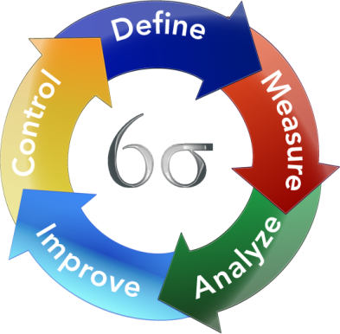
1. Automation using Programming tools
2. Process Improvement- LEAN and AGILE
5. JIRA Walkthrough

Slide 3



Automation using Programming tool
Identification & Feasibility
Choosing the right tool
Implementation- Coding + Testing

Slide 4

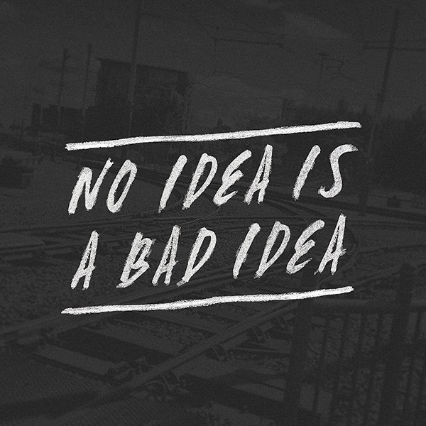
Some parameters to identify a process:
How static is your app?
How often the business rules change?
Extent of Redundancy

Slide 5


Finalizing a tool is dependant on the following factors:
1. Type of application: Web, Standalone (desktop)
2. Programming language you are comfortable with- vbScript, Java, etc.

Slide 6


Implementation: Coding and Testing
Portable, Reusable and Maintainable
Minimal human intervention
Input + Reporting on the lines of manual process
Portable and expandable
Parameterize
YES!!! You need to test something
which is designed to test something!!

Slide 7



ROBOTICS OR AUTOMATION?
Anything which replaces human effort
A simple excel macro is also a type of automation

Slide 8
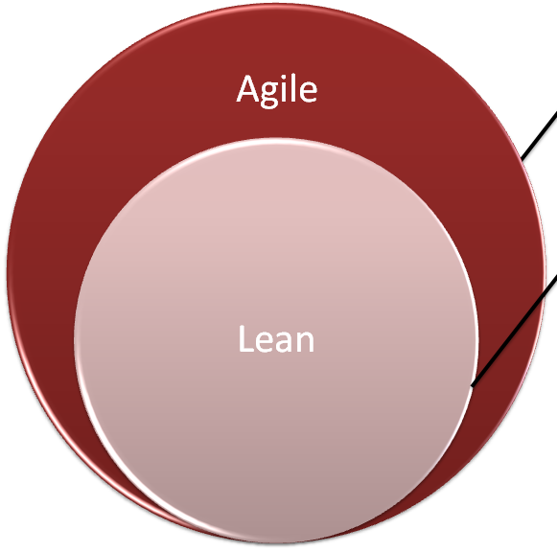
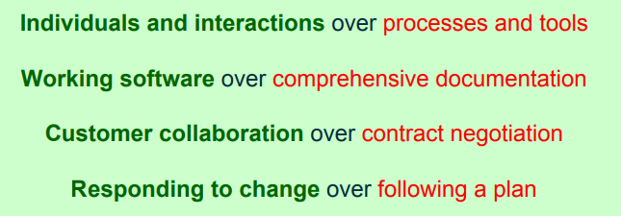
Process Improvement- LEAN & AGILE
Why?
Profit
Speed & Efficiency
Low Defects
How?
“Eliminate any waste of time, effort or money.”

Slide 9

Feedback!!!
Questions!!!
Queries!!!

